Slide 1










x
HOTEL MANAGEMENT
SYSTEM
DATA MANAGEMENT AND DATABASE DESIGN
TEAM 19
Nikhil
Jash
Keshav
Aditya
Navisha
x
OBJECTIVES
Streamline Guest Management
Optimize Room Occupancy
Enhance Guest Experience
Ensure Data Integrity
Data Validation
Enrich Data Analysis
Security
Improve Search Performance

Slide 2











x
HOTEL MANAGEMENT
SYSTEM
DATA MANAGEMENT AND DATABASE DESIGN
TEAM 19
Nikhil
Jash
Keshav
Aditya
Navisha
x
OBJECTIVES
Streamline Guest Management
Optimize Room Occupancy
Enhance Guest Experience
Ensure Data Integrity
Data Validation
Enrich Data Analysis
Security
Improve Search Performance
HIGH LEVEL DESIGN
A Hotel Management System which
Checks-In Guests
Manage reservation
Access Guest information
Prevent Double bookings
Track occupancy
Optimize pricing
Analyze Employee performance
Identify high-value customers
Optimize Room Pricing with trends
Enforced data validation
rules & secure sensitive Guest information
Dashboards for Room Sales & Generate Reports

Slide 3


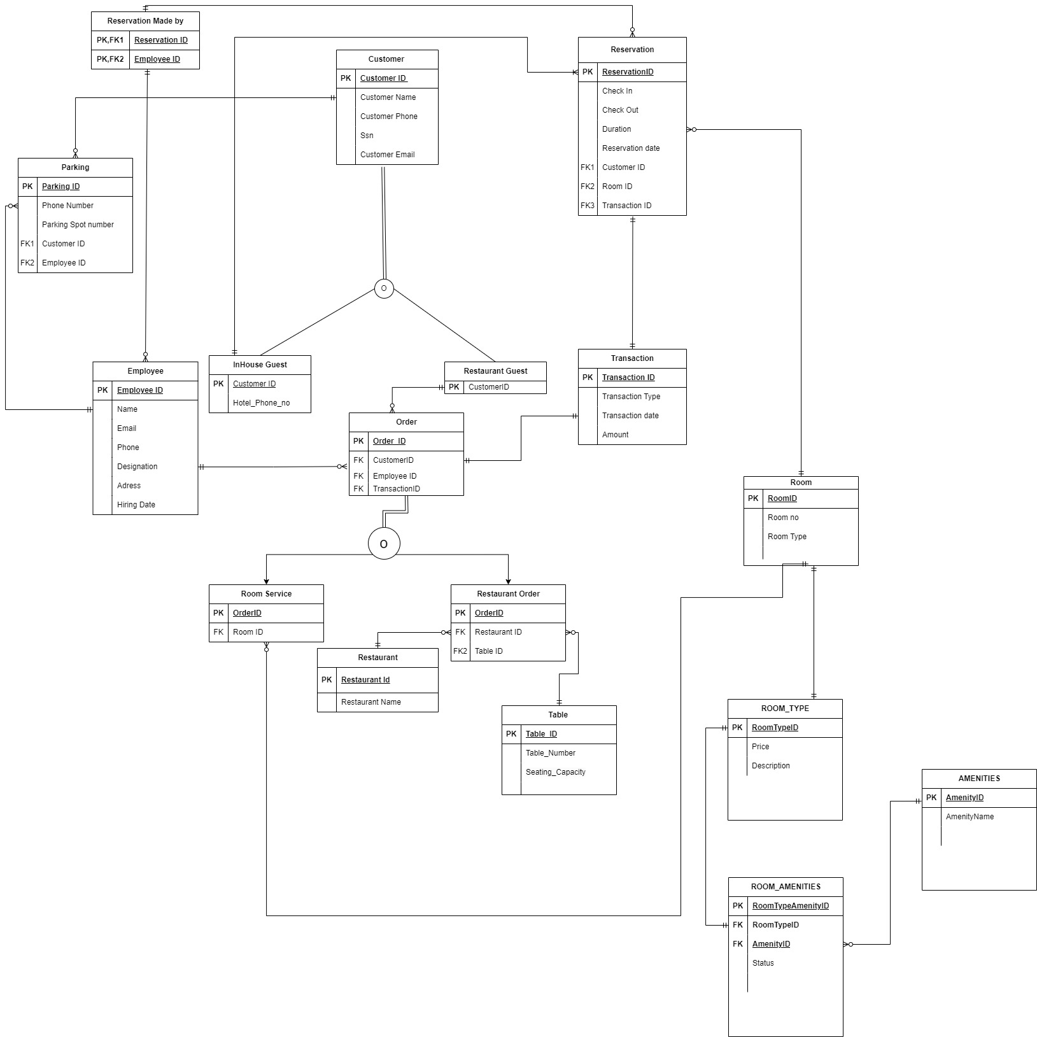
OBJECTIVES
Streamline Guest Management
Optimize Room Occupancy
Enhance Guest Experience
Ensure Data Integrity
Data Validation
Enrich Data Analysis
Security
Improve Search Performance
HIGH LEVEL DESIGN
A Hotel Management System which
Checks-In Guests
Manage reservation
Access Guest information
Prevent Double bookings
Track occupancy
Optimize pricing
Analyze Employee performance
Identify high-value customers
Optimize Room Pricing with trends
Enforced data validation
rules & secure sensitive Guest information
Dashboards for Room Sales & Generate Reports
EERD

Slide 4

HIGH LEVEL DESIGN
A Hotel Management System which
Checks-In Guests
Manage reservation
Access Guest information
Prevent Double bookings
Track occupancy
Optimize pricing
Analyze Employee performance
Identify high-value customers
Optimize Room Pricing with trends
Enforced data validation
rules & secure sensitive Guest information
Dashboards for Room Sales & Generate Reports
EERD
DATABASE OBJECTS
User Defined Functions
Stored Procedures
Views
Triggers

Slide 5


EERD
DATABASE OBJECTS
User Defined Functions
Stored Procedures
Views
Triggers

Slide 6
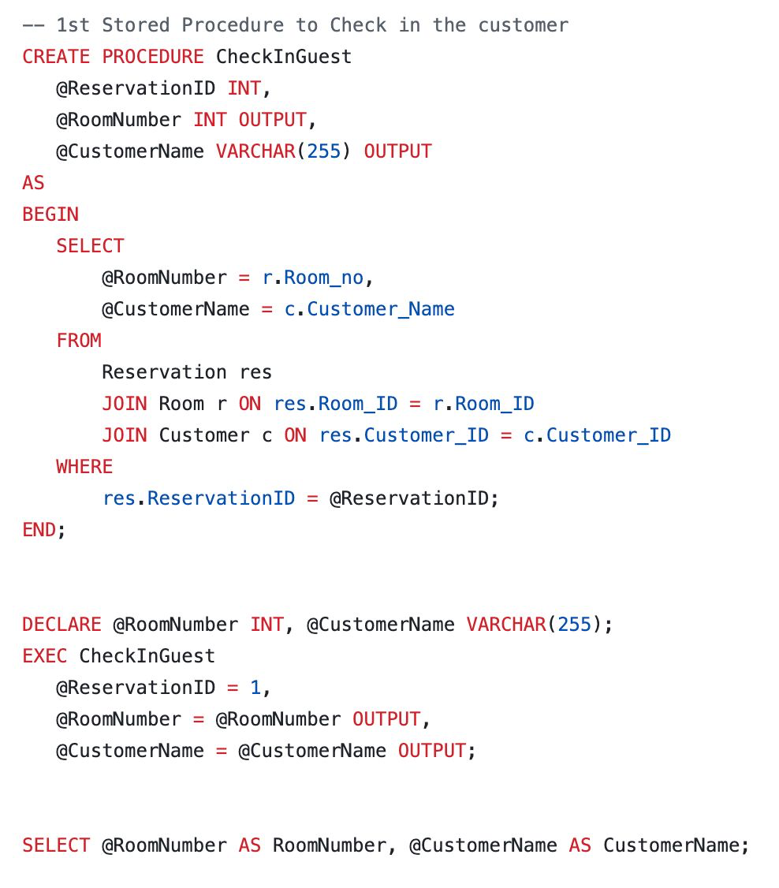
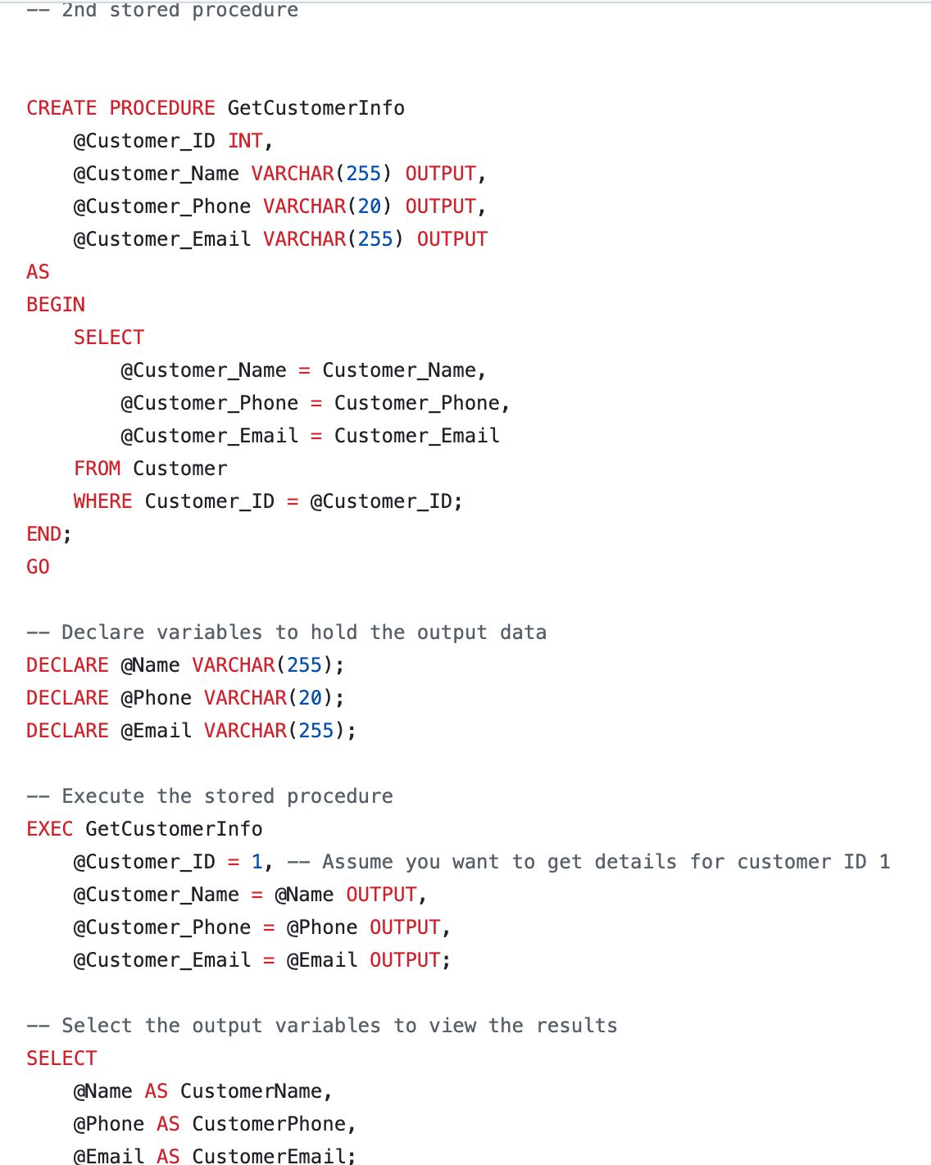
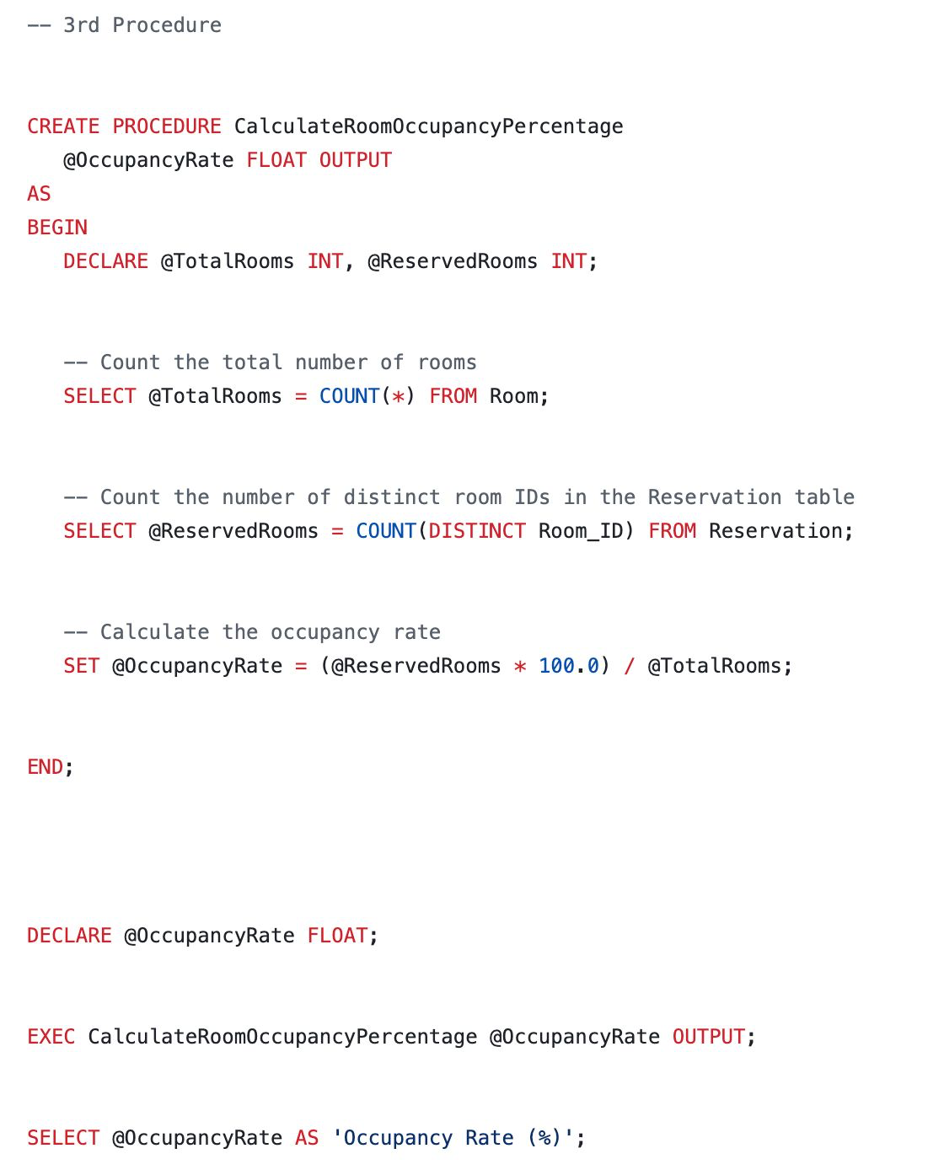


Stored Procedures
User Defined Functions
Views
Triggers

Slide 7
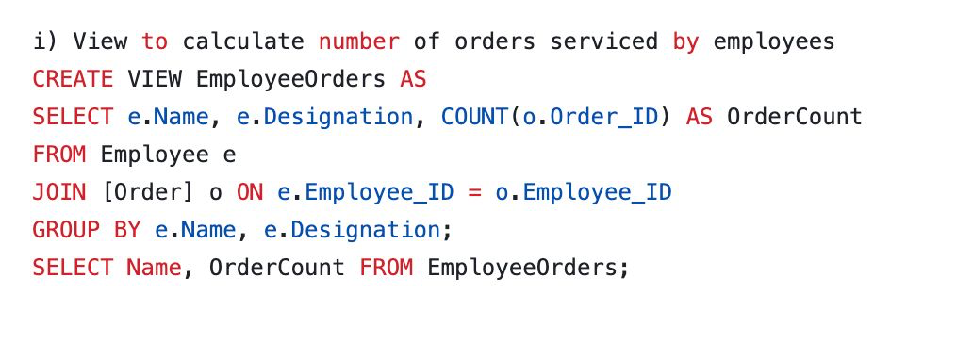
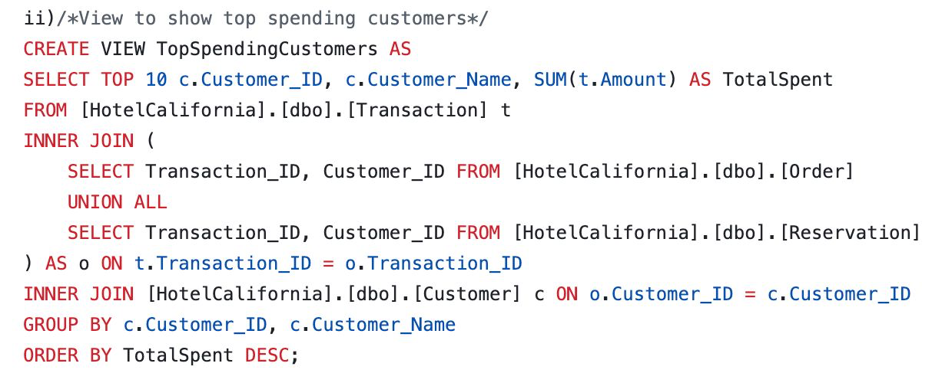

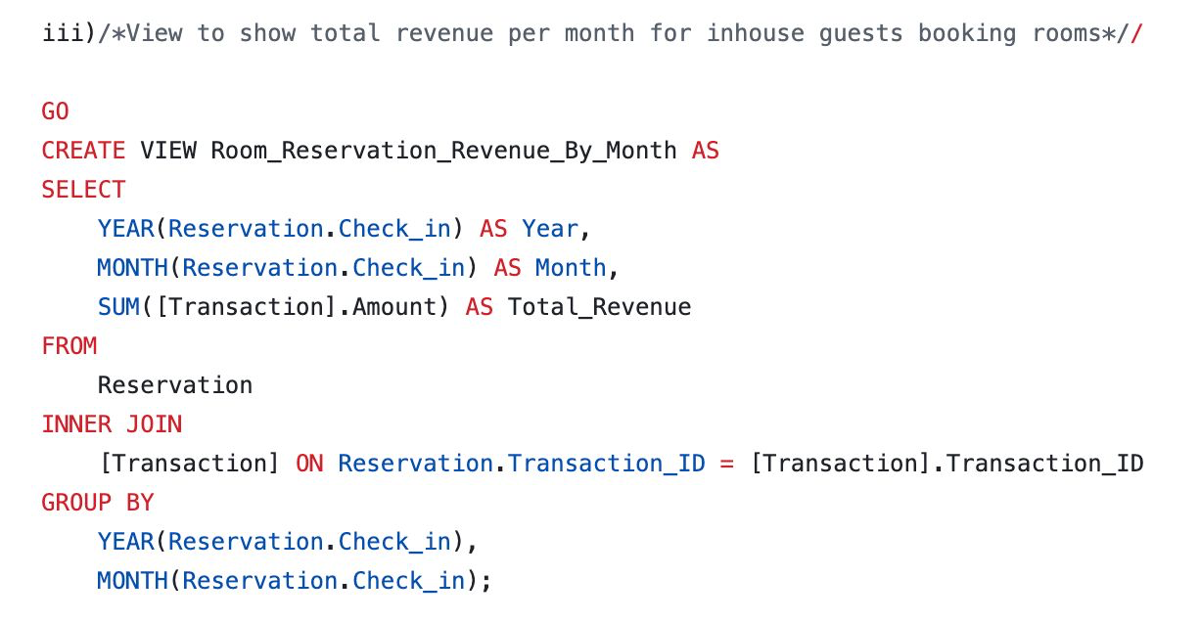
Views
User Defined Functions
Triggers

Slide 8
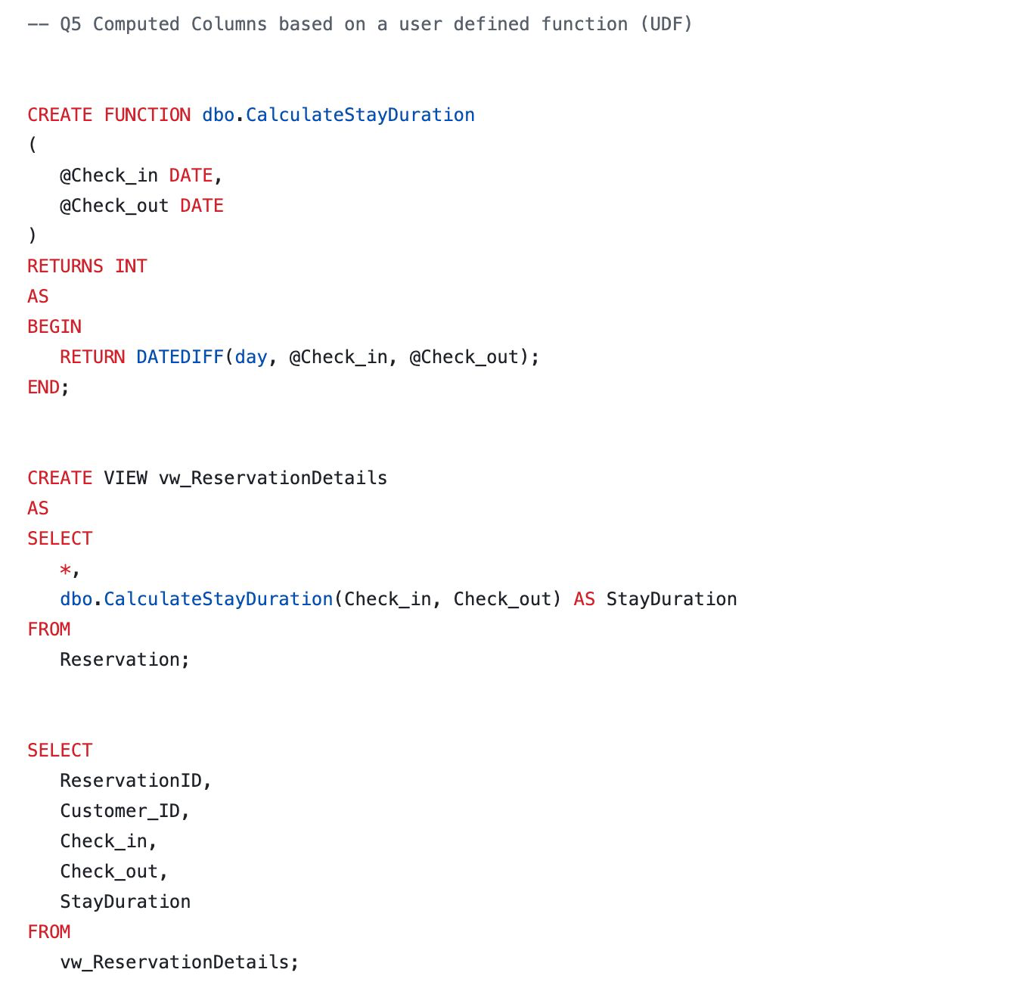


User Defined Functions
Triggers

Slide 9
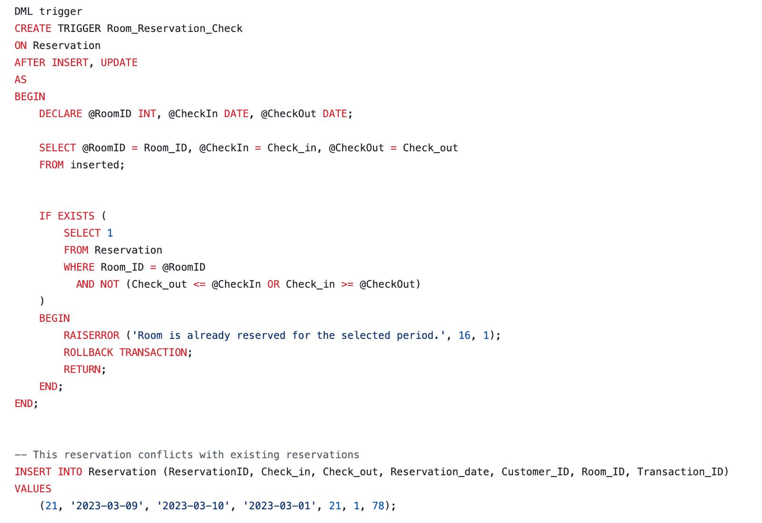

Triggers
DATA POPULATION
Added data with help of referential integrity-preserving SQL script (Insert-statements.sql).
UDFs and Triggers populate some columns, which are necessary to adhere to business regulations.
Using triggers on insert, sensitive personal customer data, such as SSN, is encrypted in the columns. Thus, the data is always encrypted on disk.
Sensitive data can be retrieved upon request by decrypting the data
Database objects are used to automatically populate computed columns

Slide 10

DATA POPULATION
Added data with help of referential integrity-preserving SQL script (Insert-statements.sql).
UDFs and Triggers populate some columns, which are necessary to adhere to business regulations.
Using triggers on insert, sensitive personal customer data, such as SSN, is encrypted in the columns. Thus, the data is always encrypted on disk.
Sensitive data can be retrieved upon request by decrypting the data
Database objects are used to automatically populate computed columns

Slide 11
DATA POPULATION
Added data with help of referential integrity-preserving SQL script (Insert-statements.sql).
UDFs and Triggers populate some columns, which are necessary to adhere to business regulations.
Using triggers on insert, sensitive personal customer data, such as SSN, is encrypted in the columns. Thus, the data is always encrypted on disk.
Sensitive data can be retrieved upon request by decrypting the data
Database objects are used to automatically populate computed columns
ANY QUESTIONS ?
REFERENCES
•https://www.w3schools.com/sql/
•https://databasefaqs.com/azure-sql-database-column-encryption/
•https://learn.microsoft.com/en-us/sql/t-sql/language-reference?view=sql-server-ver16
•https://en.wikipedia.org/wiki/Database_schema
•https://en.wikipedia.org/wiki/Relational_database
•https://en.wikipedia.org/wiki/Database_trigger
•https://en.wikipedia.org/wiki/Stored_procedure

